Slide 1
Digital Portfolio
STUDENT NAME: ROKESH
REGISTER NO AND NMID: 2426J1552/asbruaz2426j1552
DEPARTMENT: BSC INFORMATION TECHNOLOGY
COLLEGE:KPR COLLEGE OF ARTS SCIENCE AND RESEARCH/ BARATHIYAR UNIVERSITY

Slide 2
PROJECT TITLE
AI-Powered Portfolio
AI-Powered Portfolio

Slide 3


AGENDA
Problem Statement
Project Overview
End Users
Tools and Technologies
Portfolio design and Layout
Features and Functionality
Results and Screenshots
Conclusion
Github Link
3/21/2024 Annual Review

Slide 4

PROBLEM STATEMENT
Many online portfolios present static information, which limits user engagement and personalized interaction. Visitors often have specific questions about the portfolio owner’s skills, experience, and projects but have to search manually or contact the owner directly, which can be inefficient and time-consuming.
Goal: Create an AI-powered chatbot embedded in the portfolio that can interactively answer visitors' questions about the portfolio owner’s skills, experience, projects, and background. This chatbot should provide quick, relevant, and clear responses to common inquiries, improving user engagement and offering a dynamic way to showcase the portfolio owner's qualifications.

Slide 5

PROJECT OVERVIEW
This project involves integrating a simple AI-powered or FAQ-based chatbot into your portfolio website. The chatbot will answer common visitor questions about your skills, experience, projects, education, and contact details. For example, users can ask, “Tell me about your skills,” “What projects have you completed?” or “Where did you study?”
The chatbot will provide quick, relevant, and clear responses, improving visitor engagement and making it easier for potential employers or collaborators to learn about you. It will be designed to handle different variations of questions and deliver concise information in a conversational way.
By adding this interactive feature, your portfolio becomes more dynamic and user-friendly, helping to showcase your expertise and professionalism in a modern, tech-savvy format. The chatbot can also be expanded later with more advanced AI or natural language processing capabilities for even better user interaction.

Slide 6

WHO ARE THE END USERS?
Potential Employers: Recruiters and hiring managers who want quick insights into your skills, experience, and suitability for job opportunities.
Clients andAgencies Customers: Individuals or businesses looking to understand your services, expertise, and past projects before hiring or collaborating.
Peers and Industry Professionals: Colleagues or other professionals seeking to network, collaborate, or learn about your work and capabilities.
Students and Learners: People interested in your educational background or career path for inspiration or mentorship.
Event Organizers and Speakers: Those considering you for speaking engagements, workshops, or panels who need to assess your expertise.
General Visitors: Anyone casually browsing your portfolio out of curiosity or interest, wanting quick answers without navigating multiple pages.
Recruitment Agencies: looking to gather detailed information for candidate matching and referrals.

Slide 7

TOOLS AND TECHNIQUES
Chatbot Frameworks
Dialogflow: Easy NLP platform for building conversational bots.
Microsoft Bot Framework: Full SDK with Azure AI integration.
Rasa: Open-source, customizable AI chatbot framework.
Botpress: Visual chatbot builder, open-source with drag-and-drop.
2. AI/NLP Services
OpenAI GPT API: Natural, dynamic conversational AI.
IBM Watson Assistant: Enterprise AI with easy training.
Wit.ai: Free NLP service for intent recognition.
3. FAQ / Rule-Based Bots
JavaScript keyword matching or JSON Q&A for simple FAQs.
Third-party widgets like Tidio or Crisp for quick setup.
4. Frontend Integration
Use React, Vue, Angular, or plain JavaScript/HTML to embed chatbot UI.
Embed pre-built widgets with simple script tags.
5. Hosting & Deployment
Host on GitHub Pages, Netlify, or Vercel for static sites.
Use cloud functions (AWS Lambda, Azure Functions) for backend logic.
Self-host open-source bots (Rasa, Botpress) for full control.

Slide 8
POTFOLIO DESIGN AND LAYOUT
1. Clean and Simple Layout
Use a minimalist design with plenty of white space.
Clear sections: About Me, Skills, Projects, Contact.
2. Responsive Design
Ensure the portfolio looks great on desktop, tablet, and mobile.
Use flexible grids and scalable images.
3. Easy Navigation
Sticky or fixed navigation bar with clear links.
Smooth scrolling or clickable sections.
4. Highlight Key Information
Use headings, bullet points, and icons to make info digestible.
Showcase your skills and projects prominently.
5. Interactive Elements
Embed your AI chatbot in a fixed corner for easy access.
Use subtle animations or hover effects to engage visitors.
6. Visual Consistency
Choose a harmonious color palette and consistent fonts.
Keep buttons and links styled uniformly.
7. Contact and Call-to-Action
Include clear call-to-actions like “Hire Me” or “Get in Touch.”
Display contact info or form prominently.
8

Slide 9
FEATURES AND FUNCTIONALITY
Features
Easy-to-use chat window on portfolio
FAQ answers about skills, projects, and contact
Basic NLP for varied questions
Quick reply suggestions
Mobile-friendly design
Analytics to track usage
User feedback on answers
Simple FAQ updates
Contact info integration
Functionalities
Real-time chat with visitors
Keyword and intent recognition
Context-aware replies
Instant relevant answers
Suggested reply buttons
Collect usage data
Gather user feedback
Link to contact forms
Responsive UI on all devices

Slide 10
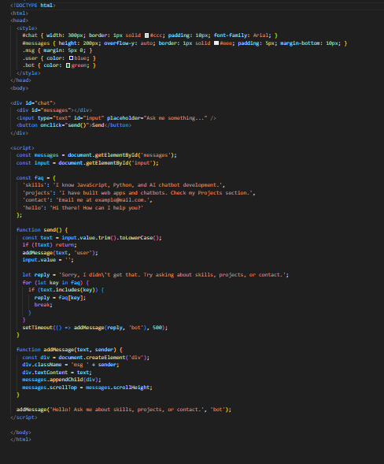
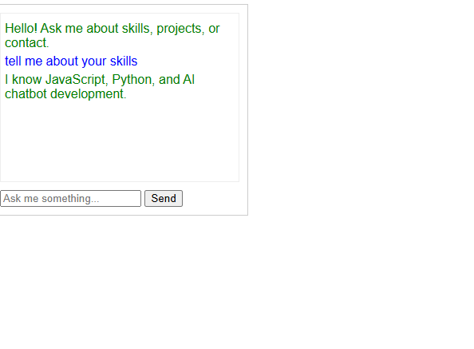

RESULTS AND SCREENSHOTS
3/21/2024 Annual Review
10

Slide 11
CONCLUSION
Integrating an AI-powered chatbot into your portfolio creates a more engaging and interactive experience for visitors. It allows potential employers, clients, and peers to quickly get answers about your skills, projects, and background without searching through static pages. By combining easy-to-use design, smart AI or FAQ-based responses, and seamless integration, this feature showcases your professionalism and tech-savviness while enhancing user satisfaction. Implementing this chatbot will make your portfolio stand out and improve communication with your audience.
https://rokesh447.github.io/index/
11

